Slide 1
Occupational Specialist Component Content: Digital Production, Design and Development
The T Level T Level Technical Qualification in Digital: Digital Production, Design and Development includes a single Occupational Specialist Component. Therefore, there is a single synoptic assessment for the Occupational Specialist Component, which is an extended ‘design, development and implementation’ project. The synoptic element of the project is important in order to ensure that students are able to demonstrate threshold competence: this is the principal reason why the Occupational Specialism is assessed via a single extended project assessment to ensure that students are able to evidence all the skills required by the Performance Outcomes.
The T Level Technical Qualification in Digital: Digital Production, Design and Development Occupational Specialist Component consists of several activities grouped into four substantive tasks.
Each task will be completed during a window set by Pearson during which you will schedule supervised assessment sessions. In some cases, tasks will also involve opportunities for unsupervised activities where the requirements of the skills being assessed make this necessary.

Slide 2
The unit outcomes
1.4 Understand and define the functional and non-functional requirements of a software solution
An understanding of the concept of ‘secure by design’ and how this influences the decisions made regarding functional and non-functional requirements.
An understanding of and ability to define functional requirements of a software solution
An understanding of and ability to define non-functional requirements of a software solution.
Understand the use of ‘spike testing’ as an early product-testing method to establish requirements and determine the extent of the problem and the required scope of a software solution.

Slide 3
Learning Objectives
Aims
To understand and define Functional and Non-Functional requirements of a software solution.
Objectives
To be able to understand
How to define functional and non-functional requirements
The concept of secure by design and its impact on software design
Key performance and usability metrics
The role of spike testing in early requirement gathering

Slide 4
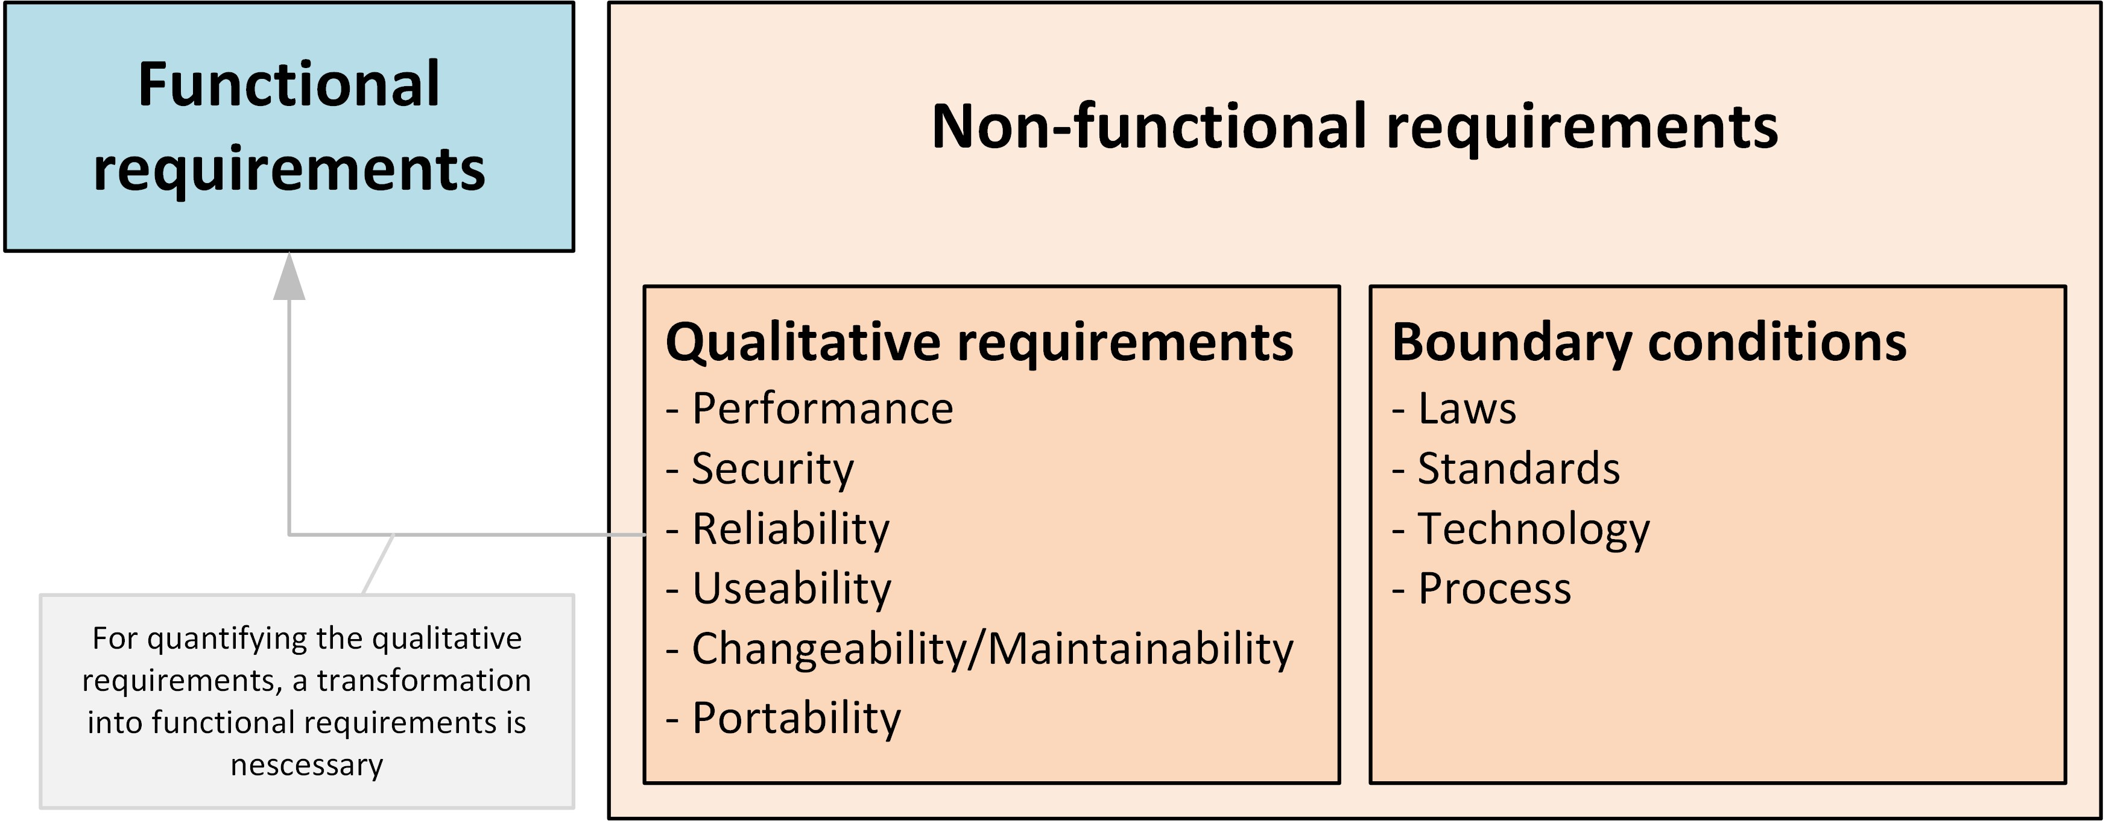
What Are Software Requirements?
Software requirements describe the expected behaviour and constraints of a system.
They guide development, testing, and deployment decisions and must align with user and business needs.
Software requirements should describe:
What the system should do. (Functional Requirements)
How the system should perform. (Non-Functional Requirements)
The foundation for system design, testing, and validation.
How they align with business goals and user needs.

Slide 5
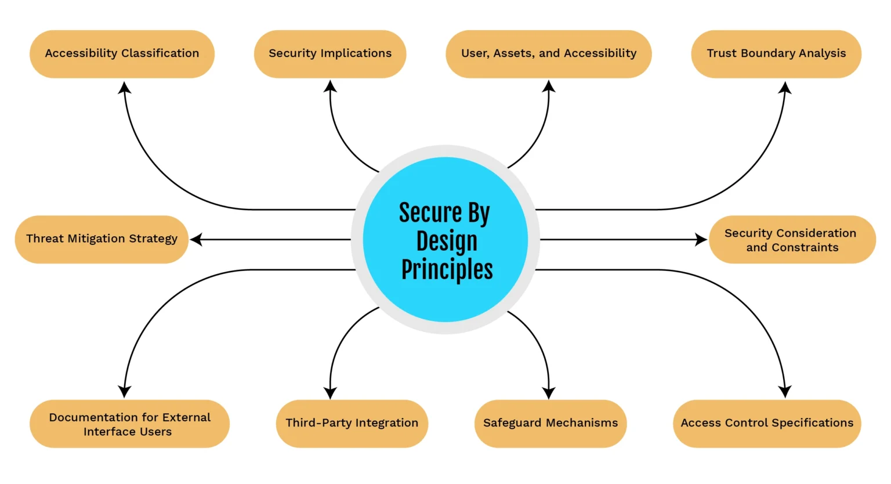
Secure by Design
"Secure by design" means integrating security into every part of the system from the start.
This principle affects both what the system does (functional) and how it performs (non-functional), helping to prevent security flaws later on.
Secure by design should not be added as an afterthought.
It Influences both functional and non-functional requirements.
It should reduce vulnerabilities and enhances trust.
It should lead to decisions like:
Data validation and encryption (functional)
Role-based access and audit trails (non-functional)
Secure APIs and third-party integrations
Notes:
https://www.einfochips.com/blog/secure-by-design-principles-for-external-accessible-interfaces/
https://www.softwareimprovementgroup.com/resources/security-by-design-in-9-steps/
https://www.solcept.ch/en/blog/critical-systems/secure-by-design/
https://reciprocity.com/resources/what-is-security-by-design/
For a long time, the topic of information security was neglected, because in the market the demand for functional requirements was greater than the demand for non-functional requirements.
Information security is a non-functional requirement, and implementing it costs money and time.
Secure by design means that software engineers have designed the software to be secure from the outset so as to reduce the likelihood of flaws that might compromise a company's information security.
An effective approach to cybersecurity risk management requires a complete cybersecurity lifecycle perspective.
The advent of networked devices (IoT, IIoT, Things, etc.) means that devices that were previously secure by design in their intended environment (no connection to the Internet) are now no longer secure.

Slide 6
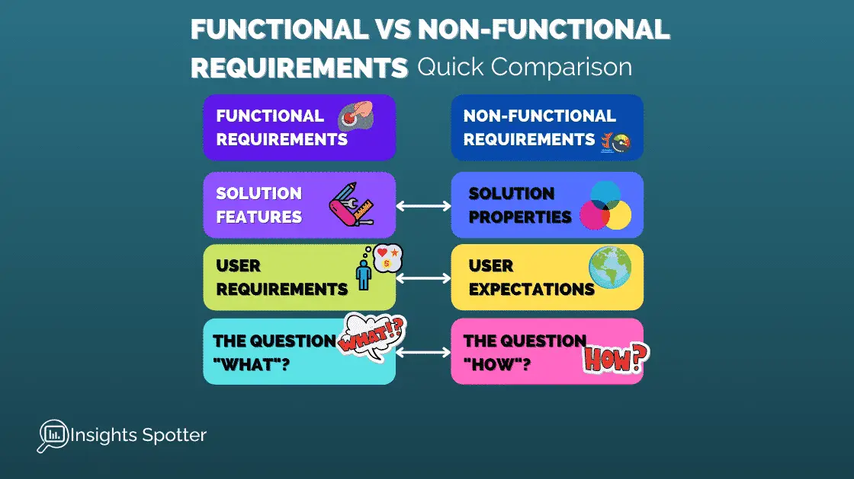
Defining Functional Requirements
Functional requirements define the core behaviour of the software.
These include how the software handles inputs, processes data, applies business rules, and how it will be used or deployed
Functional Requirements Include:
Inputs: What data is collected or entered
e.g., User login credentials, form submissions
Data Needed: What data must be stored or fetched
e.g., User profiles, product inventory
Example:
Use Case: Online Booking System
Inputs: User date selection, payment info
Data Needed: Availability, user details, payment status
Processing: Check availability, validate card, confirm booking
Logic: Bookings must not overlap; only available slots shown
Deployment: Mobile-first responsive web application
See slide notes for further examples
Data Processing: Transformations, validations, calculations
e.g., Order total calculation, input sanitization
Logic of the System: Decision-making rules and workflows
e.g., Access control rules, business logic flows
Deployment & Usage Platforms: Where and how the software runs
e.g., Web app, mobile app, desktop platform, cloud environment
Notes:
https://insightspotter.com/non-functional-vs-functional-requirements-how-to-be-successful/
Functional Requirements
A functional requirement defines a system or its component.
It specifies “What should the software system do?
Functional requirement is specified by User.
It is mandatory.
It is captured in use case.
Defined at a component level.
Helps you verify the functionality of the software.
Functional Testing like System, Integration, End to End, API testing, etc are done.
Usually easy to define.
Example
1) Authentication of user whenever he/she logs into the system. 2) System shutdown in case of a cyber attack. 3) A Verification email is sent to user whenever he/she registers for the first time on some software system.
Non-Functional Requirements
A non-functional requirement defines the quality attribute of a software system.
”It places constraints on “How should the software system fulfil the functional requirements?”
Non-functional requirement is specified by technical peoples e.g. Architect, Technical leaders and software developers.
It is not mandatory.
It is captured as a quality attribute.
Applied to a system as a whole.
Helps you to verify the performance of the software.
Non-Functional Testing like Performance, Stress, Usability, Security testing, etc are done.
Usually more difficult to define.
Example
1) Emails should be sent with a latency of no greater than 12 hours from such an activity. 2) The processing of each request should be done within 10 seconds 3) The site should load in 3 seconds when the number of simultaneous users are > 10000

Slide 7
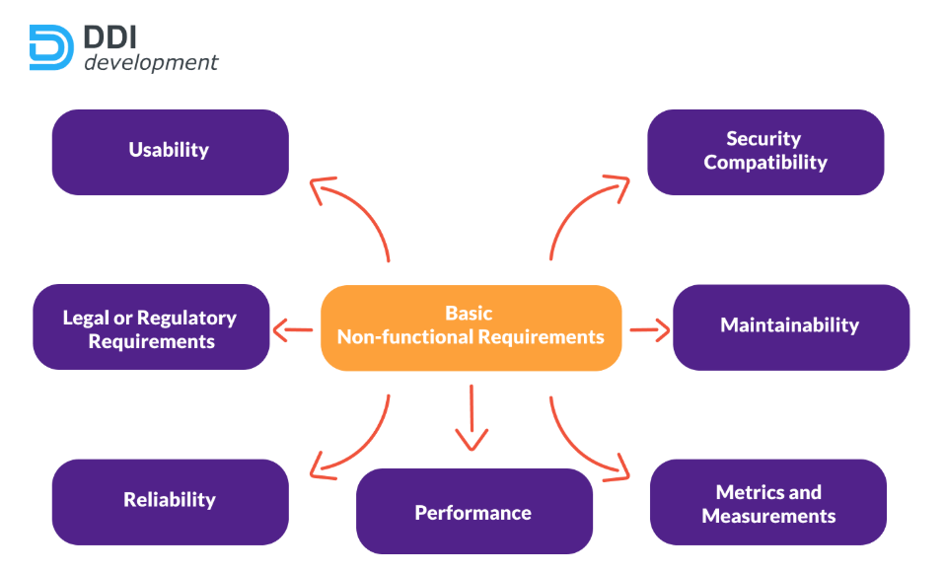
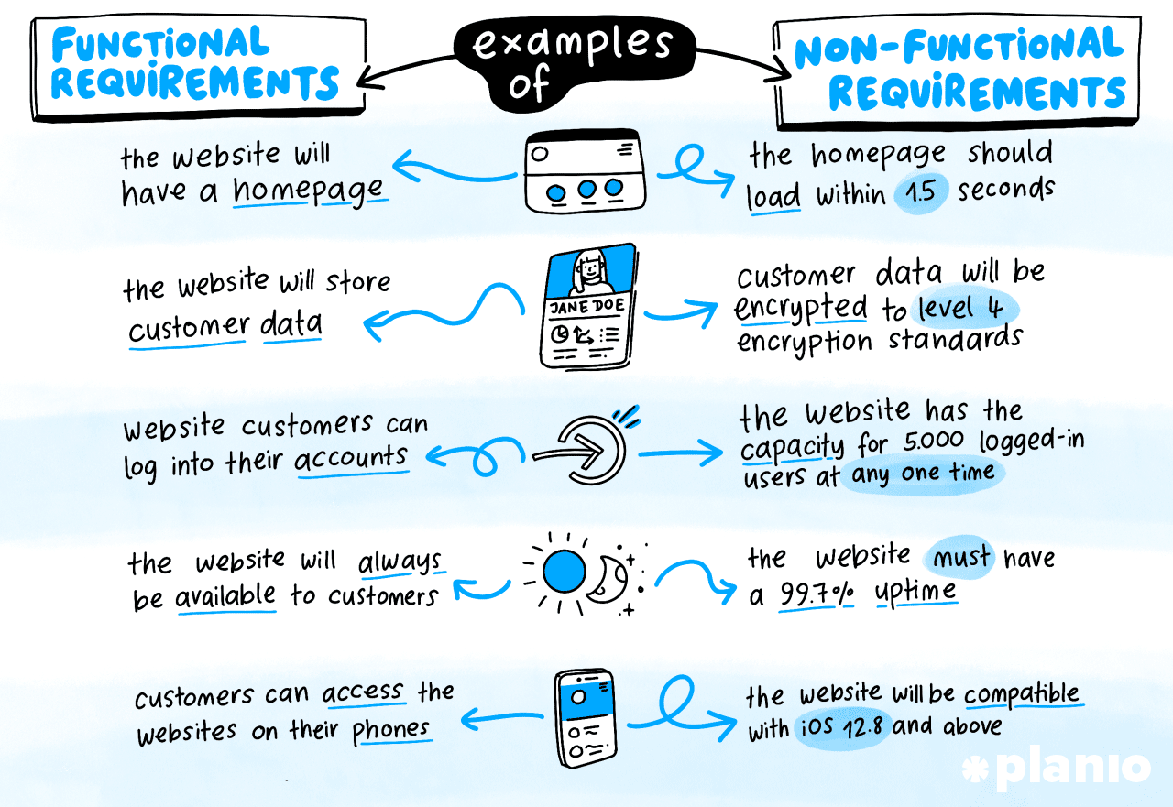
Understanding Non-Functional Requirements
Non-functional requirements describe the quality attributes of a system, such as its performance, accessibility, and security.
They ensure the system is usable, reliable, and scalable.
Non-Functional Requirements focus on:
Security:
Authentication, encryption, secure storage
Accessibility:
WCAG compliance, screen reader support, keyboard navigation
Scalability:
Ability to support growth (users, data, features)
Performance Metrics:
Responsiveness: Page load time, latency
Load Handling: Concurrent users, data throughput
Reliability: Uptime %, error rates
User Acceptance Criteria:
Measures for successful deployment (usability, satisfaction, task success)
Notes:
https://www.modernrequirements.com/blogs/what-are-non-functional-requirements/
Functional Requirements
A functional requirement defines a system or its component.
It specifies “What should the software system do?
Functional requirement is specified by User.
It is mandatory.
It is captured in use case.
Defined at a component level.
Helps you verify the functionality of the software.
Functional Testing like System, Integration, End to End, API testing, etc are done.
Usually easy to define.
Example
1) Authentication of user whenever he/she logs into the system. 2) System shutdown in case of a cyber attack. 3) A Verification email is sent to user whenever he/she registers for the first time on some software system.
Non-Functional Requirements
A non-functional requirement defines the quality attribute of a software system.
”It places constraints on “How should the software system fulfil the functional requirements?”
Non-functional requirement is specified by technical peoples e.g. Architect, Technical leaders and software developers.
It is not mandatory.
It is captured as a quality attribute.
Applied to a system as a whole.
Helps you to verify the performance of the software.
Non-Functional Testing like Performance, Stress, Usability, Security testing, etc are done.
Usually more difficult to define.
Example
1) Emails should be sent with a latency of no greater than 12 hours from such an activity. 2) The processing of each request should be done within 10 seconds 3) The site should load in 3 seconds when the number of simultaneous users are > 10000

Slide 8
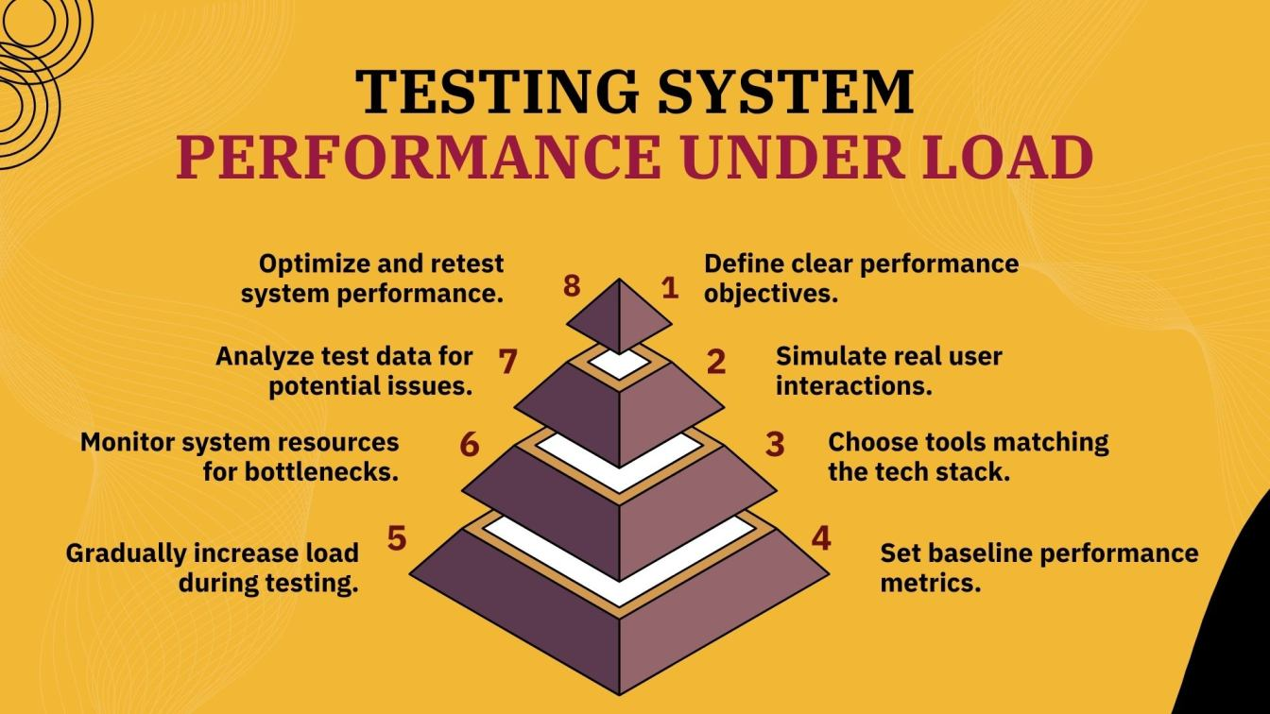
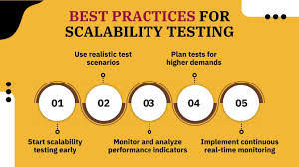
Measuring Performance and Scalability
Performance and scalability metrics help ensure the software can respond quickly and grow as user demand increases.
These are key for maintaining quality under load.
Key Metrics Include:
Response Time: Time to complete a request
Throughput: Requests per second
System Load: CPU, memory usage
Uptime: Target availability (e.g., 99.9%)
Elasticity: Can the system scale up/down as needed?
Notes:
https://www.frugaltesting.com/blog/how-to-test-the-scalability-of-software-systems-best-practices
Non-Functional Requirements
A non-functional requirement defines the quality attribute of a software system.
”It places constraints on “How should the software system fulfil the functional requirements?”
Non-functional requirement is specified by technical peoples e.g. Architect, Technical leaders and software developers.
It is not mandatory.
It is captured as a quality attribute.
Applied to a system as a whole.
Helps you to verify the performance of the software.
Non-Functional Testing like Performance, Stress, Usability, Security testing, etc are done.
Usually more difficult to define.
Example
1) Emails should be sent with a latency of no greater than 12 hours from such an activity. 2) The processing of each request should be done within 10 seconds 3) The site should load in 3 seconds when the number of simultaneous users are > 10000

Slide 9
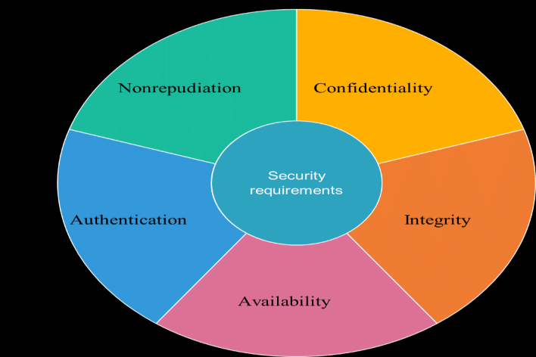
Security Considerations in Non-Functional Requirements
Security is a critical non-functional requirement.
It involves protecting data, managing access, and ensuring secure interactions with external systems and users.
Security considerations in non-functional requirement are:
Secure communication protocols (e.g., HTTPS, TLS)
Role-based access and least privilege
Input validation and protection from injection attacks
Regular updates and patching policy
Logging and monitoring for intrusion detection
Notes:
https://requirements.com/Content/What-is/what-are-security-requirements

Slide 10
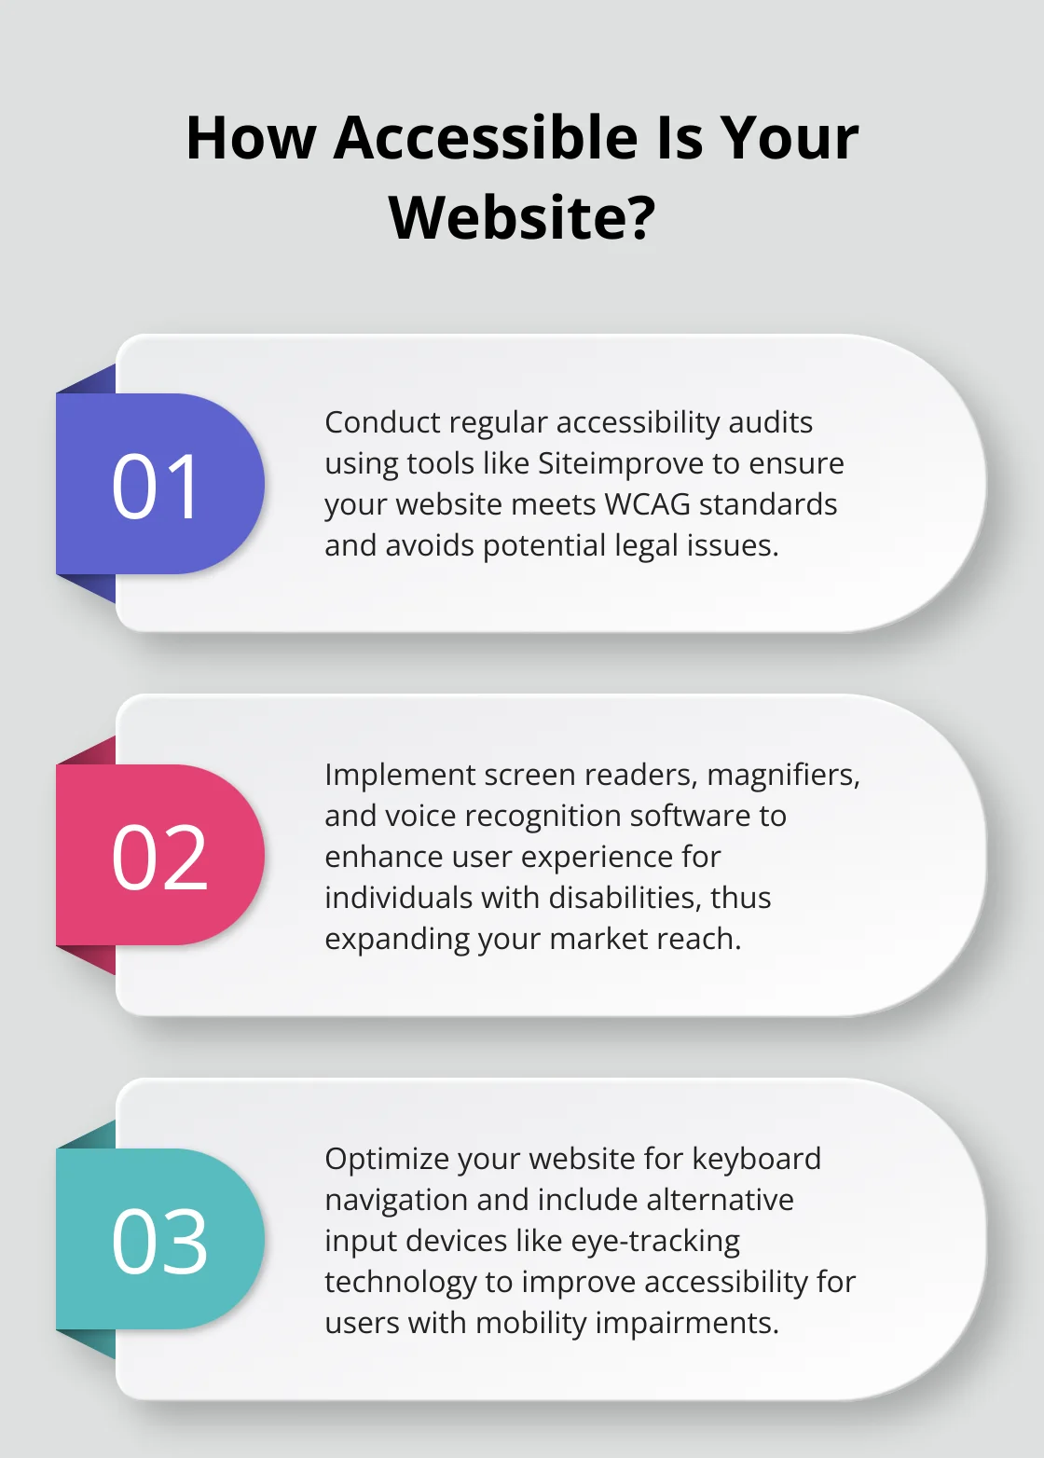
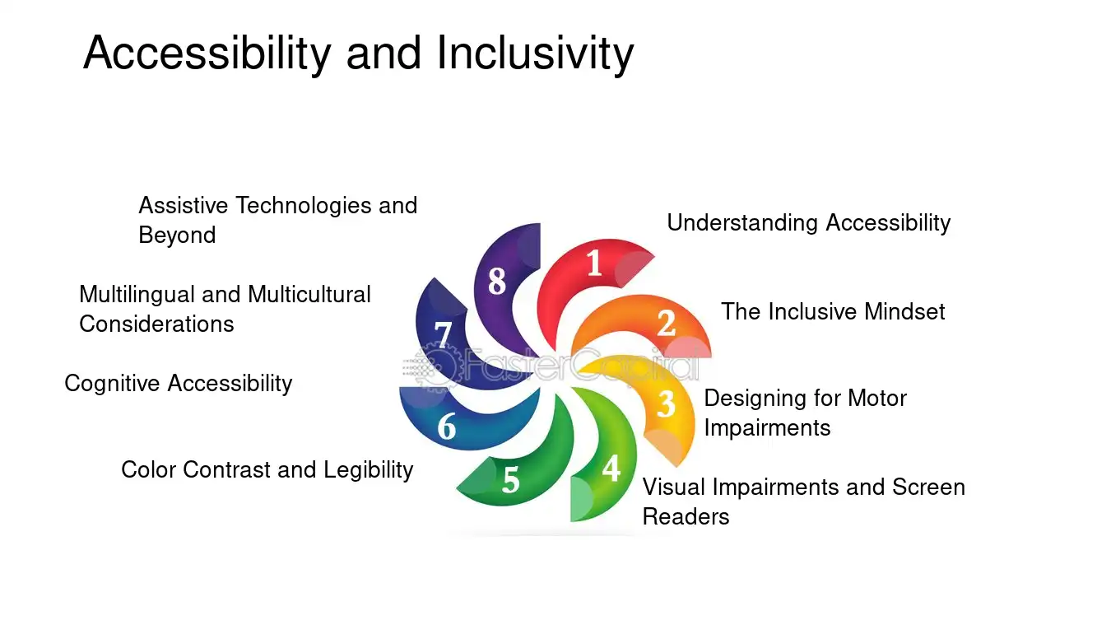
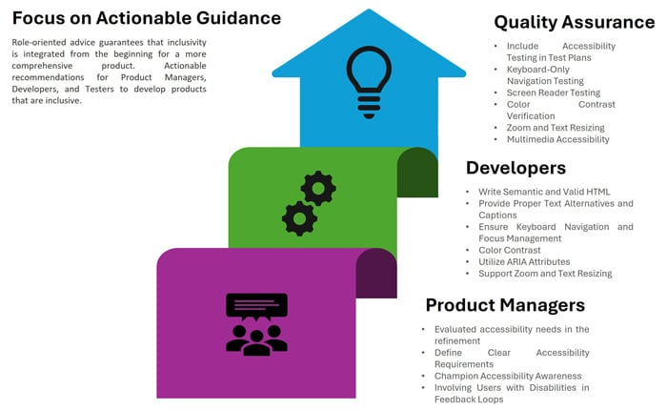
Accessibility and Inclusivity
Accessibility ensures that software can be used by people with a wide range of abilities.
It’s both a usability requirement and a legal/ethical obligation in many domains.
Accessibility and Inclusivity should focus on:
Support for assistive technologies
High contrast modes, text-to-speech
Multilingual options
Clear and consistent navigation
Test for accessibility across devices
Notes:
https://fastercapital.com/topics/the-importance-of-accessibility-and-inclusivity.html/1
https://aredgroup.com/what-digital-accessibility-tools-mean-for-inclusivity/
https://www.infosys.com/iki/techcompass/embedding-accessibility-software-development-lifecycle.html

Slide 11
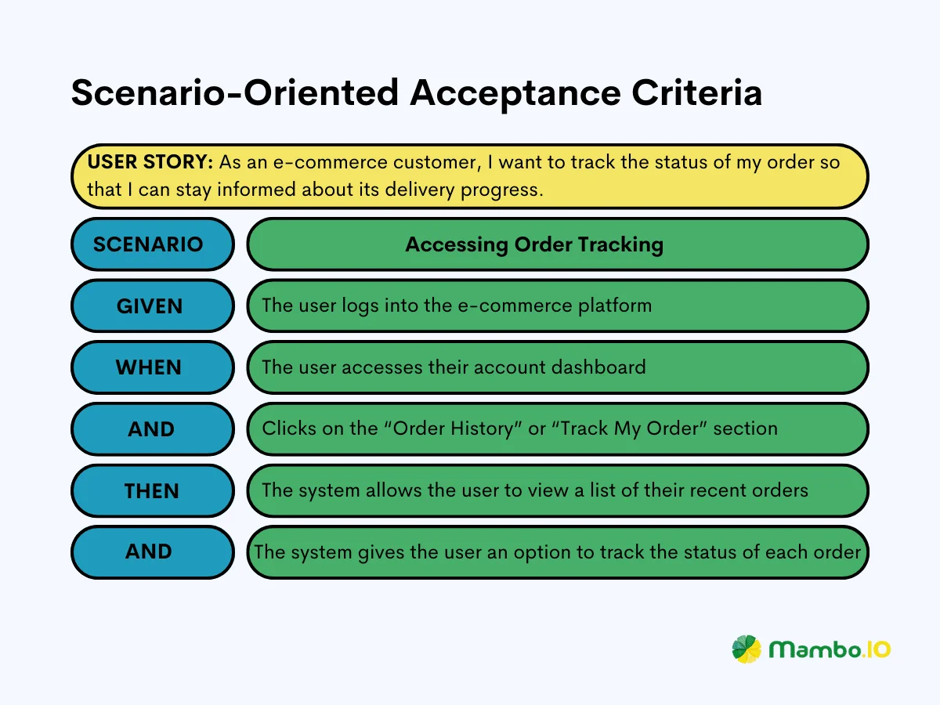
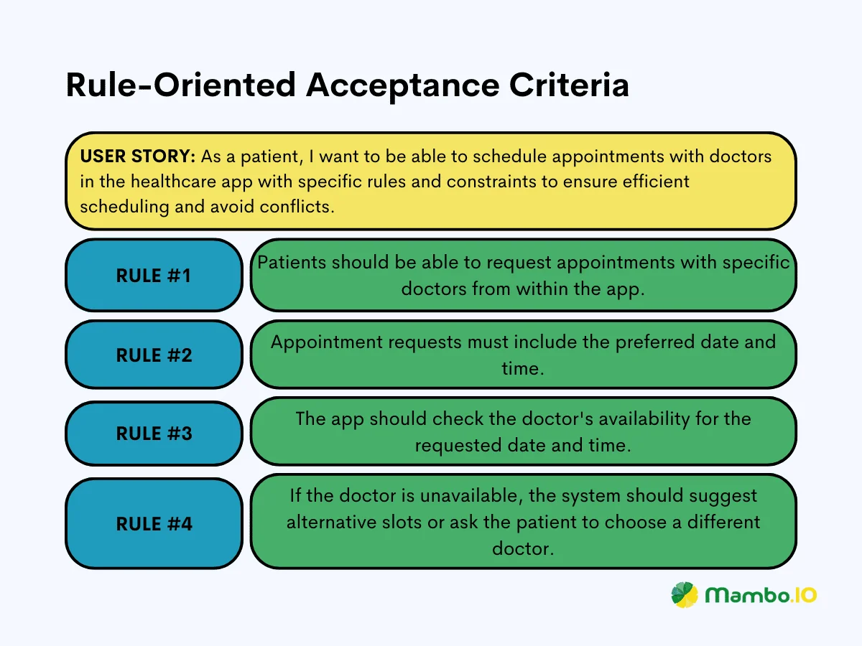
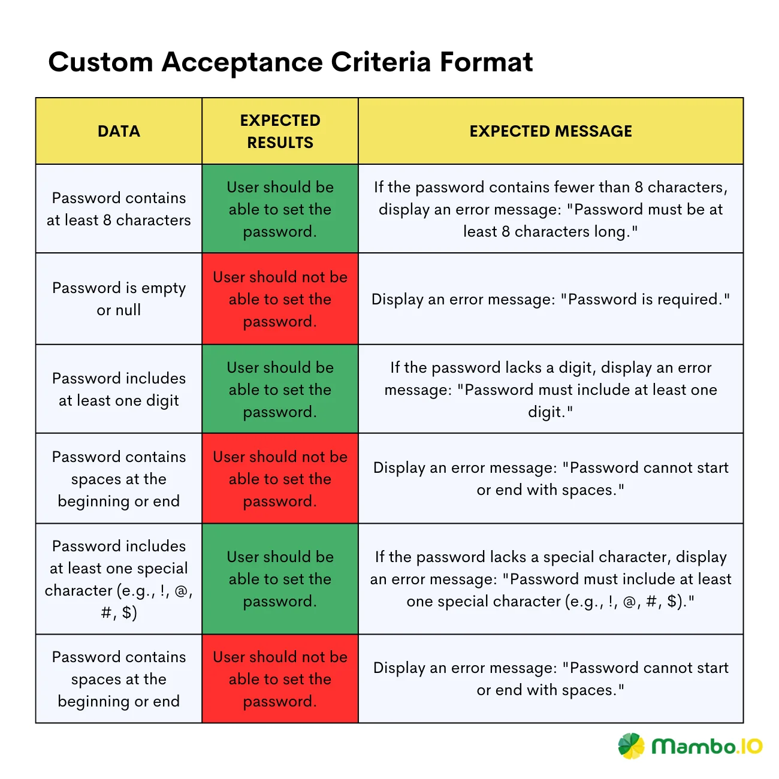
Defining User Acceptance Criteria
User acceptance criteria are measurable conditions that must be met for the software to be considered complete.
They validate that both functional and non-functional expectations have been fulfilled.
Defining User Acceptance Criteria should:
Clearly defined success measures
Includes functional correctness and performance benchmarks
Examples:
“User can complete registration in < 2 minutes”
“System must support 100 concurrent users with < 2s response time”
Basis for sign-off and release readiness
Notes:
https://mambo.io/blog/acceptance-criteria

Slide 12
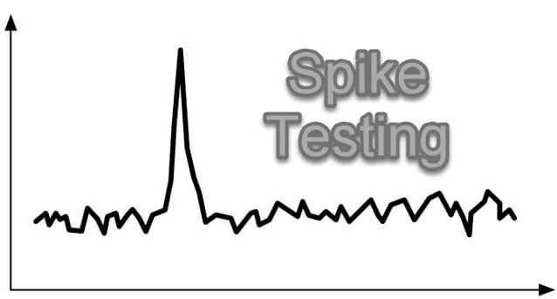
Spike Testing
Spike testing is a quick investigation to explore a risky or unknown part of a project.
Purpose
To help identify technical challenges early and informs more accurate requirement gathering.
Example – Spike Testing in Action
Scenario:
A New API integration with unknown rate limits
Testing
Conduct a spike test to simulate multiple requests
Observe system limits and bottlenecks
Use results to define realistic performance and scalability requirements
Benefits:
Helps estimate effort
Clarifies the scope
Informs architecture and requirement decisions
Notes:
https://blog.nashtechglobal.com/spike-testing-assessing-software-performance-under-sudden-load-changes/

Slide 13
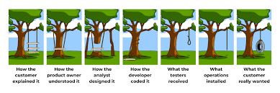
Activity - Understanding Software Requirements
You’ll work in your teams to analyse a real-world software scenario and define its:
Functional Requirements
Non-Functional Requirements
Security Features using the Secure by Design principle
Your Task:
Each team member will focus on one aspect of the requirements.
You'll collaborate to build a full picture of what the system must do, how it will perform, and how it will remain secure and scalable.
Goal:
Deliver a structured requirement document and a 5-minute presentation outlining your solution.

